Slide 1
Educational
Decision Support System
Guided by:- Presented by:-
Mr. Abhijit Kumar Himanshu sati(092)
Arunit Gupta (098)
Saurabh Tandan(099)
Sandeep Kumar(091)

Slide 2
Outline of the Project
Decision support for choosing Elective subjects.
Categorization of students.
Retrieval of learning material/Information based on student’s knowledge level.
Topic Sensitive PageRanking.
References.

Slide 3
Objectives
To provide decision support for choosing elective subject based on student’s past performances.
Categorize Student on the basis of their marks(past performance) into 3 categories :-
Beginner, Intermediate, Advanced
Learning material/information Retrieval Module : which will help in extracting the exact and accurate information from the www(World Wide Web).

Slide 4
Literature Survey
“A Knowledge-Driven Educational Decision Support System “Vo Thi Ngoc Chau, Nguyen Hua Phung Faculty of Computer Science and Engineering Ho Chi Minh City, University of Technology Ho Chi Minh City, Vietnam 2011.
“TopicSensitive PageRank” Taher H. Haveliwala Stanford University Computer Science Department Stanford 2003.

Slide 5
Technology Used
Created web interface for our system using Visual Studio 2008.
Created Database for our system on Sql Server 2008 r2 using result of CSE branch.

Slide 6
Decision Support System
Our decision support system recommends best combination of elective subject to fourth year student of our college based on their previous marks in various supporting subjects.
Student can submit their request to educational manager and finally manager decides the best combination of electives with the help of DSS and his own intelligence.

Slide 7
Student Categorization
Categorization of Students
We have evaluated student’s knowledge structure based on his/her past performance based and students were categorized into 3 categories as:-
Beginner
Intermediate
Advanced
Based on this classification our system helps a student to use the resources better.

Slide 8
Illustration of Algorithm used for categorizing students
Aggregate score = x;
If ( X>= 75)
{ Student belongs to advanced category}
If ( 60<=X<75)
{ Student belongs to Intermediate category}
If ( X<60)
{ Student belongs to Beginner category}

Slide 9
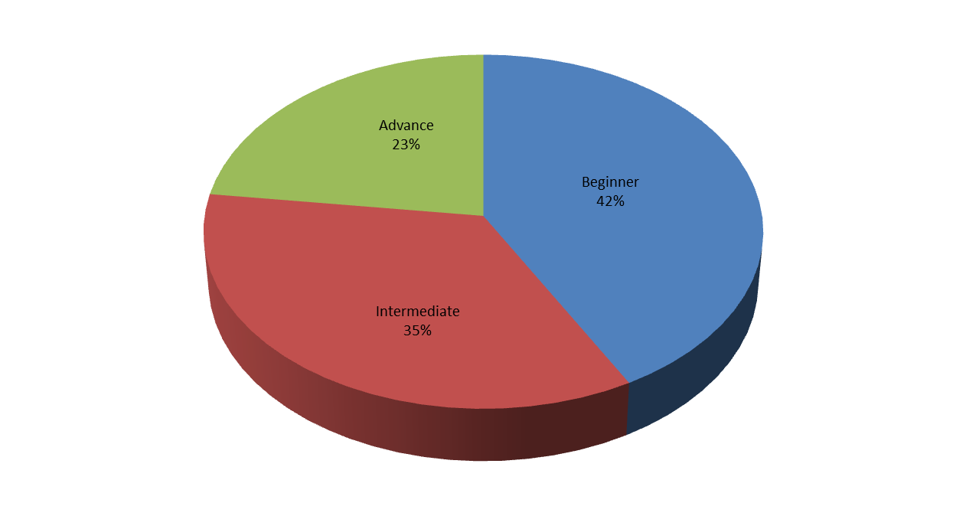
Example : Students Categorization

Slide 10
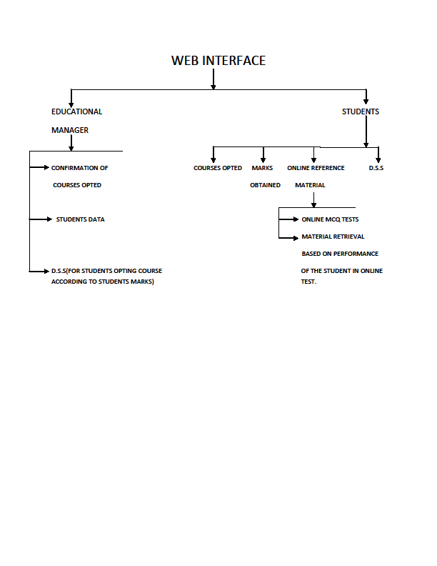

Slide 11
Designing of Information Retrieval Module based on Student knowledge level
World Wide Web (www) is a huge digital library containing lots of information.
Many search engines like Google, yahoo, bing etc. are available for retrieving web pages from the World wide web (www).
We have used Google search engine for retrieving the learning material. We filter the retrieved web pages and divide them into three categories.
  Beginner
  Intermediate
  Advanced

Slide 12
Topic Sensitive Pagerank
In TSPR instead of computing a single rank vector, we compute a set of rank vectors, one for each (basis) topic.
Calculated in 2 steps :-
  Pre-processing
  Query-processing
Topic-Sensitive PageRank formula :
  r = IPR(G,v)

Slide 13
Step - 1
Consider some page i and 16 topics (categories) :
  We can pick them from the first level of ODP http://www.dmoz.org
  Step 1 is performed once, offline, during preprocessing of Web crawl.
For each topic c_{j} ε v
{
// Part 1 : Calc v_{j}
v_{j}[ i ] = 0;
if ( i ε pages(c_{j}) ) {
v_{j}[ i ] = 1 / num( pages(c_{j}) )
}
// Part 2 : Calc r_{j}
r_{j}[ i ] = IPR(W, v_{j}[ i ]);
}

Slide 14


Step - 2
Calculate the composite PageRank score using the following formula :
Interpretation of the composite score :
Weighted sum of rank vectors itself forms a valid rank vector.

Slide 15
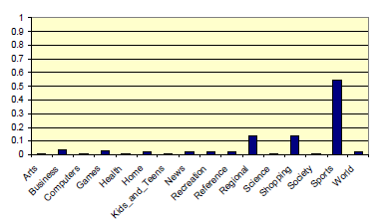
For Example :-
Query is “golf”.
With no additional context, the distribution of topic weights we would use is :

Slide 16
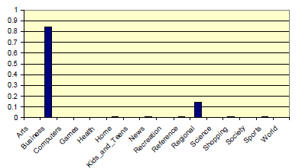
Query is “golf”, but the previous query was “financial services investments”.
Distribution of topic weights we would use is :

Slide 17
Similarity Measures used to compare two rankings:
  Osim(T1,T2):
  Indicates the degree of overlap between the top n URLs of two rankings.
  Ksim(T1,T2):
  Indicates the degree to which the relative orderings of the top n URLs of two rankings are in agreement.

Slide 18
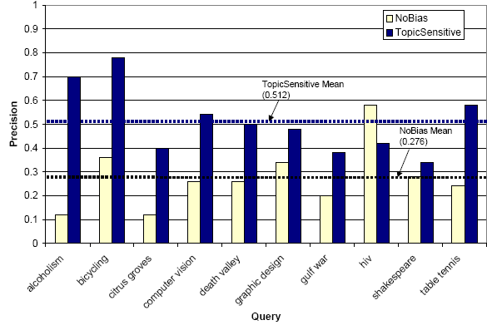
Comparison of topic sensitive pagerank with unbaised pagerank
The average precision for the rankings induced by the topic-sensitive PageRank scores is substantially higher than that of the unbiased PageRank scores.
These results suggest that the effectiveness of a query-result scoring function can be improved by the use of a topic-sensitive Page-Rank scheme.

Slide 19
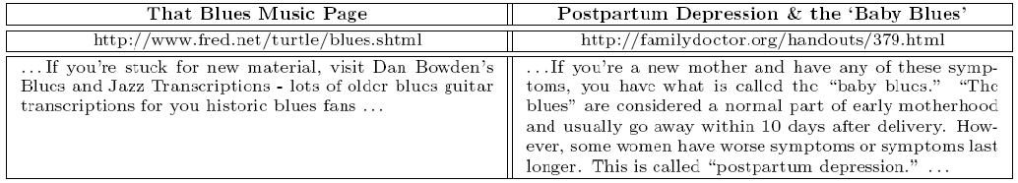
For Example :-
Query is “blues”.
First step is to calculate P(cj|q’) using for q’ the terms of the entire page
Next step is to use a text index to fetch a list of URLs for alll documents containing term “blues”.
Finally URLs are ranked using the appropriateranking vectors that was selected using P(cj|q’) values.

Slide 20
Searching algorithm based on student knowledge level
Using K-mean clustering algorithm we cluster the links into three cluster c₀,c₁,c₂.
Where c₀ represents cluster of basic search user (beginner) material
Where c₁ represents cluster of Intermediate user search material &
Where c₂ represents cluster of Advance user search material.

Slide 21
Step3
Searching _algorithm (students categorize, cluster to be search)
{
// Student’s categorize represents input parameter obtained from the previous module//
//Cluster c₀,c₁,c₂… to be search is Output parameter//
If (Student = = Basic)
Cluster=c₀
Else if (student = = Intermediate)
Cluster=c₁
Else if (student = = Advance)
Cluster=c₂
}

Slide 22

Screenshots

Slide 23


Slide 24
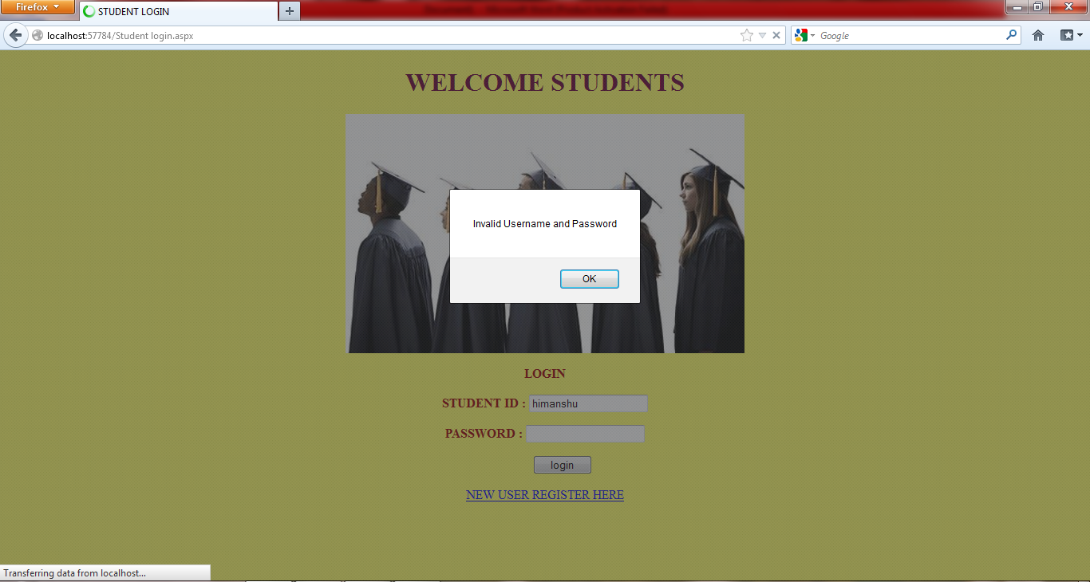


Slide 25


Slide 26
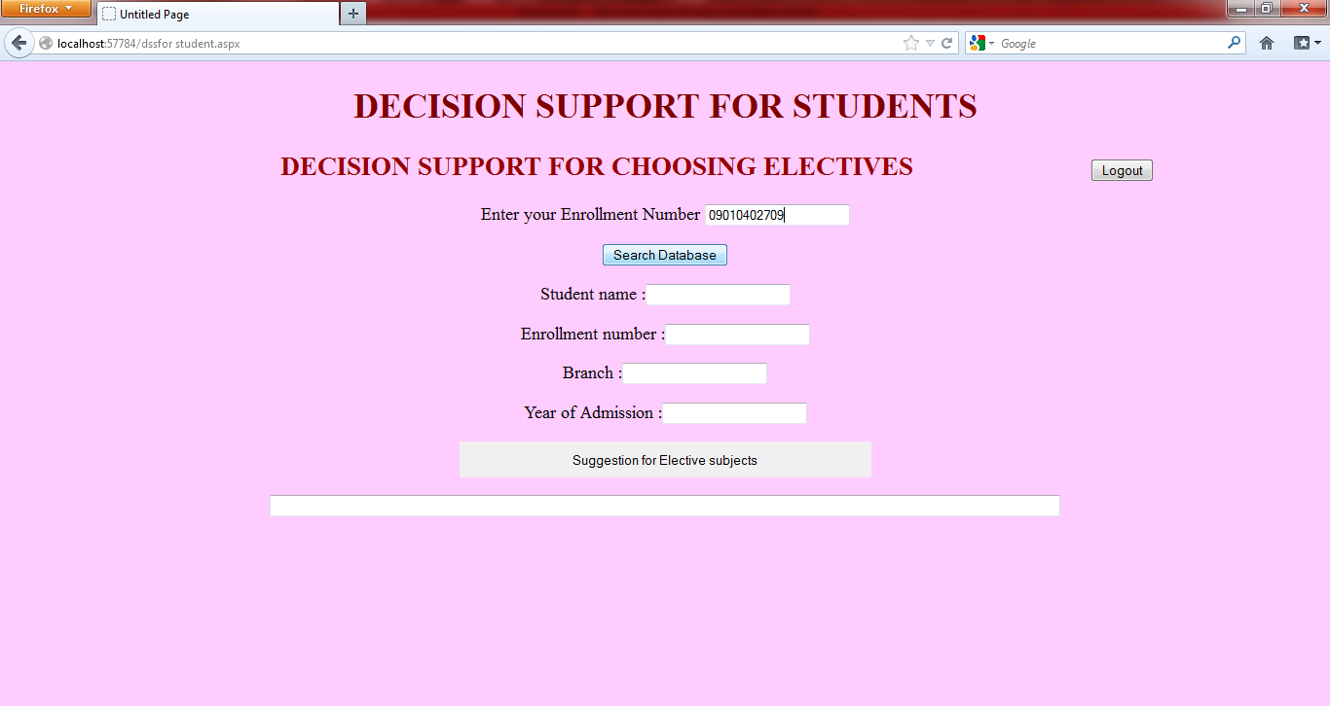

Slide 27
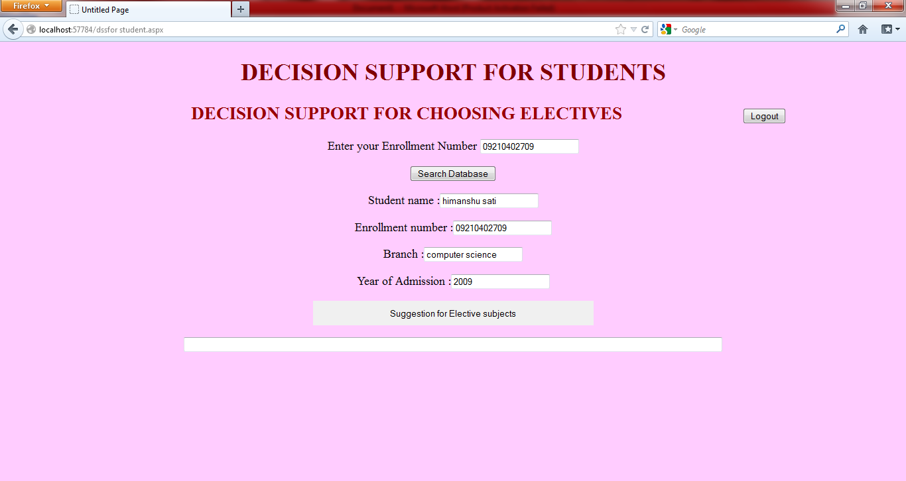

Slide 28
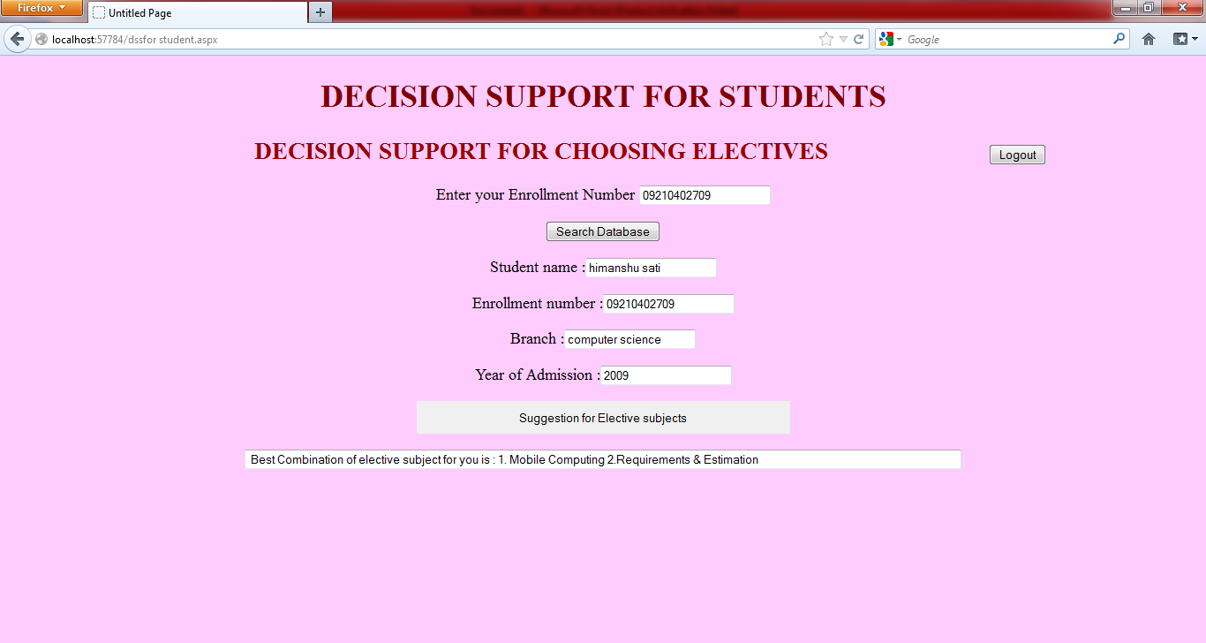

Slide 29
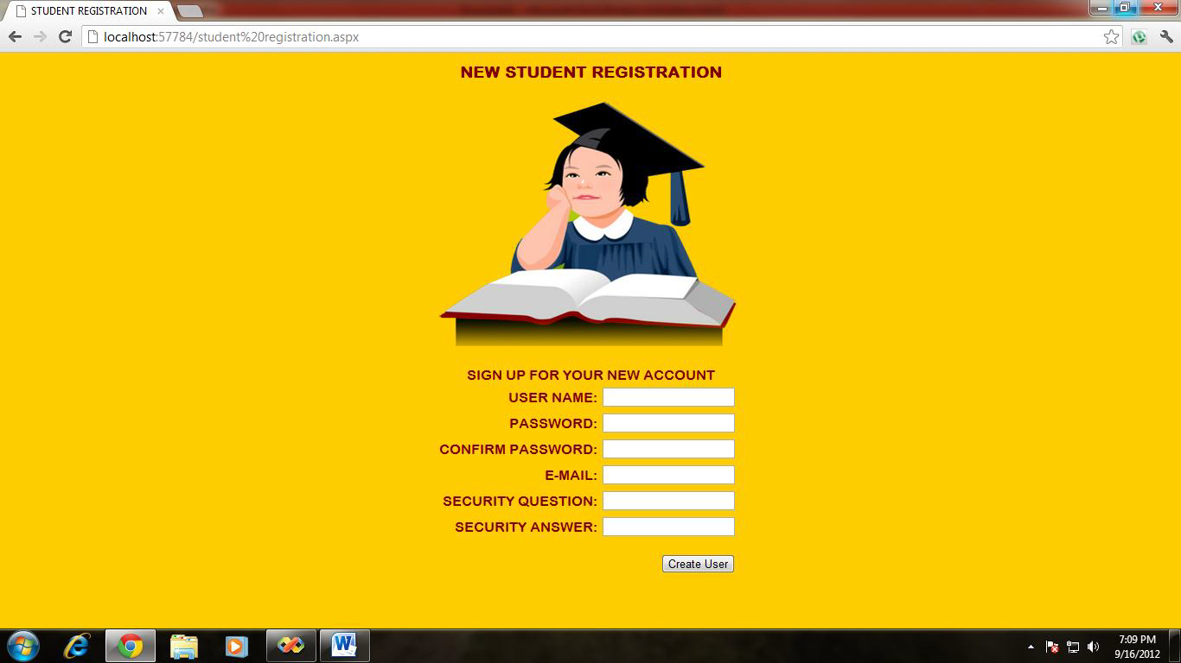

Slide 30
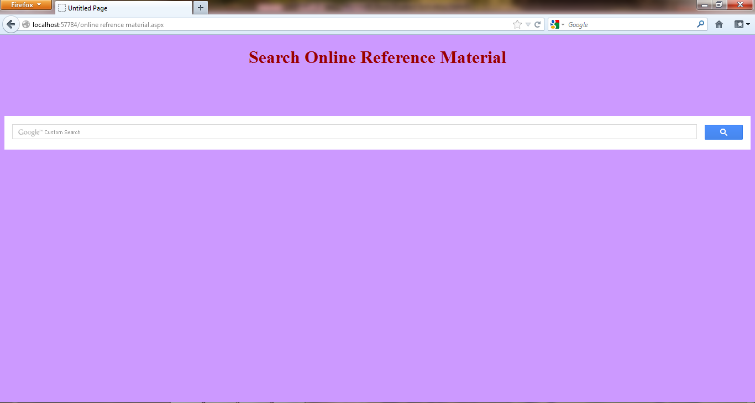

Slide 31
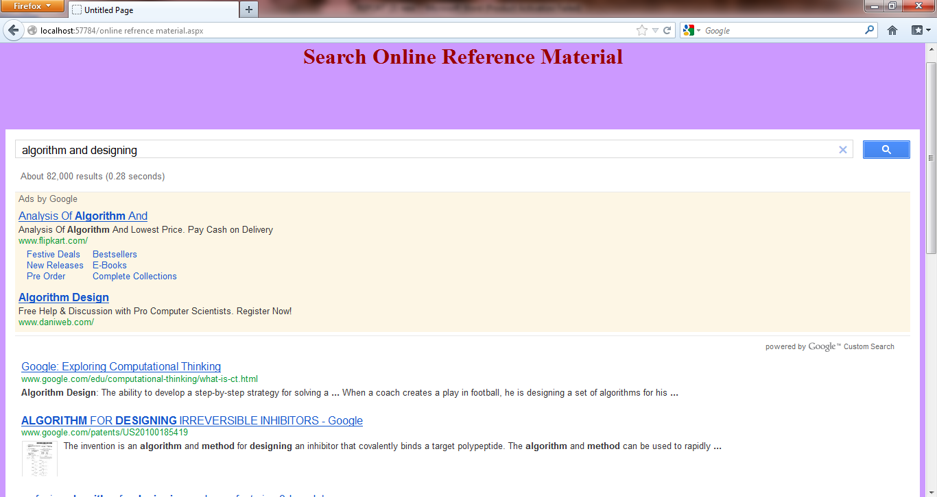

Slide 32


Slide 33


Slide 34
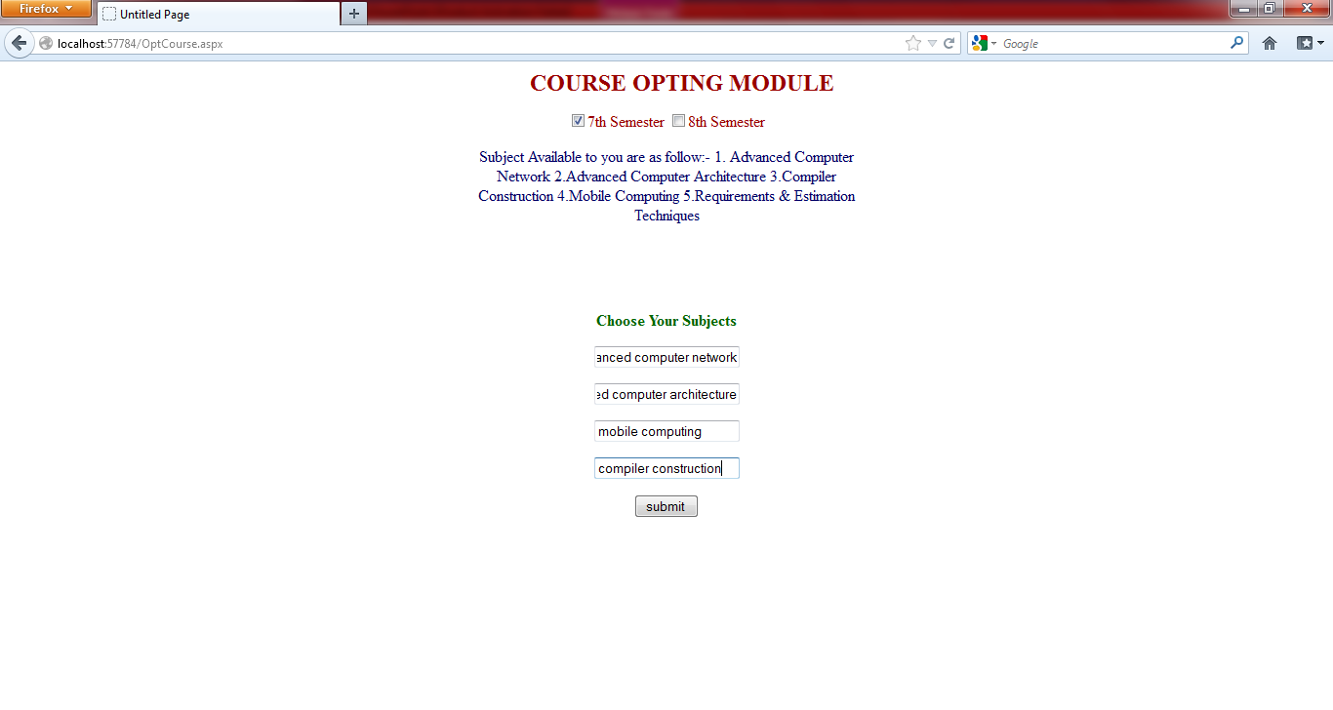

Slide 35
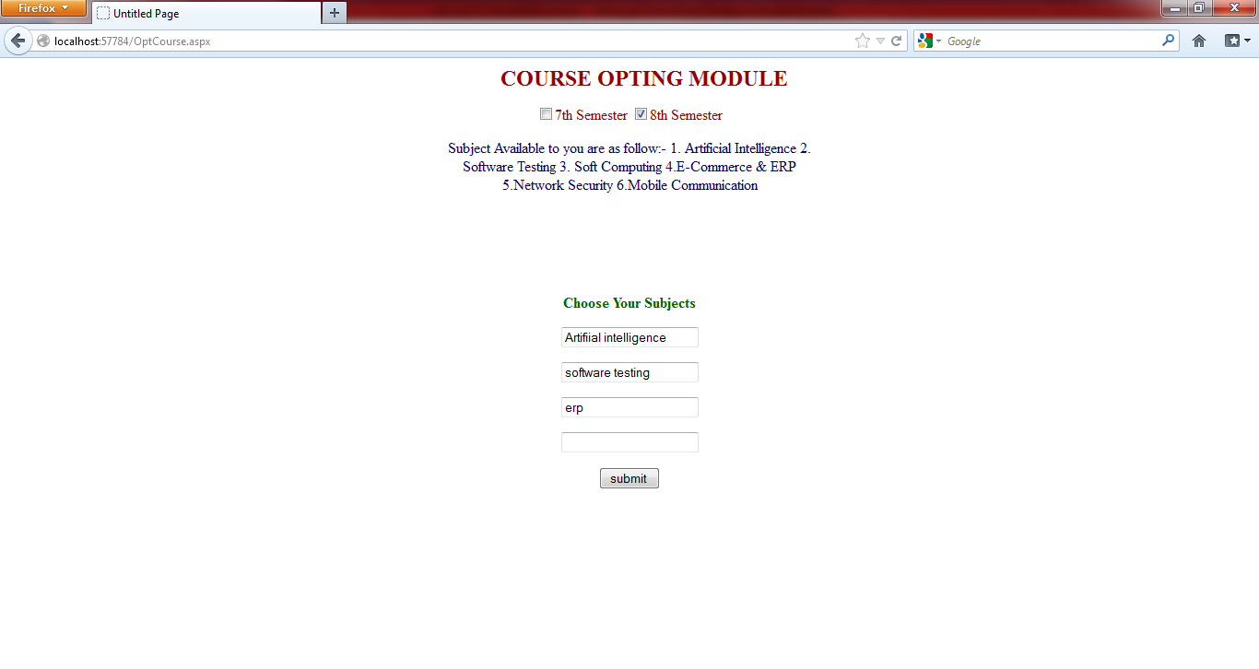

Slide 36
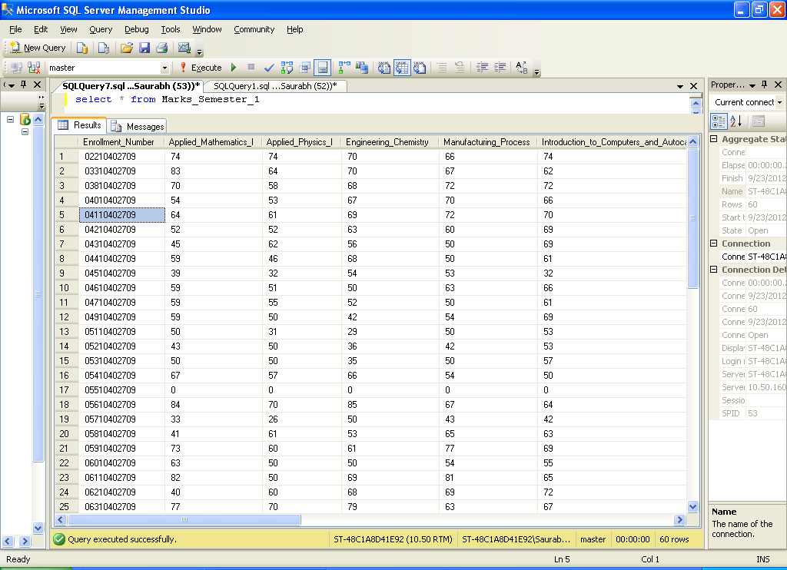
Database Screenshots

Slide 37
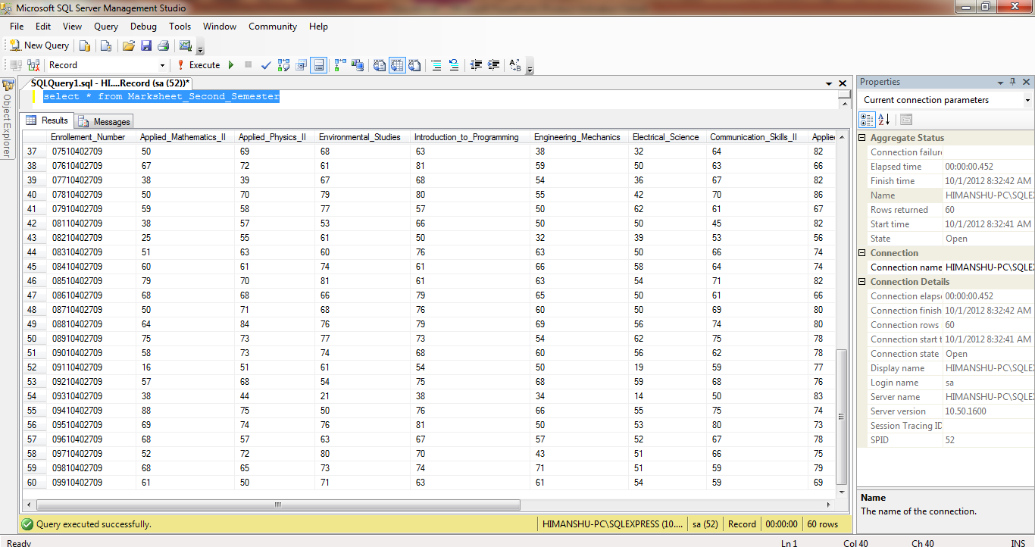

Slide 38
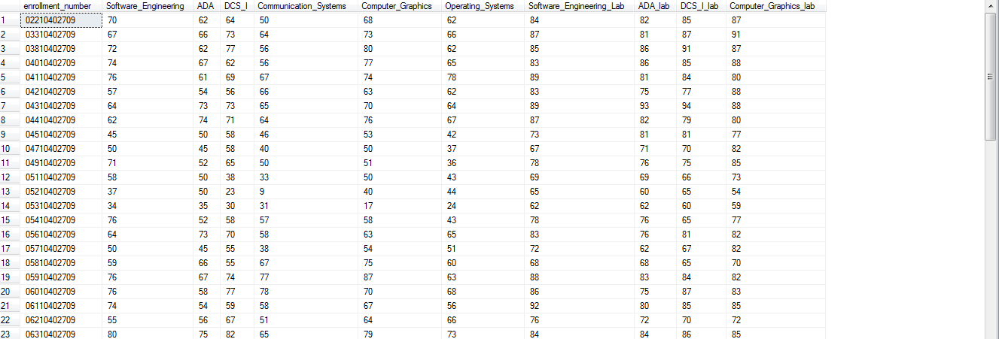


Slide 39
Future Scope
The system can be generalized for a university or for an institution.
Student categorization can be done by conducting an online aptitude examination for the entire registered student.
Inputs from the student can be increased like hobbies, favorite subjects, work experience details, industrial training, academic projects; this will enhance the DSS capability and can provide a wide variety of decisions.
Information retrieval or content searching can be enhanced or can be customized to a greater extend by implementing better algorithms.

Slide 40
References
Vo Thi Ngoc Chau, Nguyen Hua Phung , “A Knowledge-Driven Educational Decision Support System”, in IEEE RIVF International conference, University of Technology Ho Chi Minh City, Vietnam 2011, pp. 1-6.
Taher H. Haveliwala ,“TopicSensitive PageRank”, in the Proceedings of the 11th international conference on World Wide Web, Standford University,Standford, 2003, pp.517-526.
M. Zorrilla, D. Garcia, and E. Alvarez, “A Decision Support System to Improve e-Learning Environments,” in Proc. of EDBT 2010, 2010.
D. Z. Deniz and I. Ersan, “An Academic Decision-Support System Based on Academic Performance Evaluation for Student and Program Assessment,” Int. J. Engng Ed., vol. 18, pp. 236-244, 2002.

Slide 41
THANK YOU

